Slide 1
Situative existential partitive constructions in Estonian and Finnish
Rodolfo Basile
17.09.2022

Slide 2
What are situative constructions (situatives)?
Novel locational strategies: functionally either existential constructions (given location, new LOCATUM) or locative constructions (given LOCATUM, new location)
Defined in Basile (2021, 2022)
Predicate has complex lexical aspect (e.g. durative + punctual)
Dynamic verb vs static predication
Predicate situates referent in concrete/abstract location
Loss of prototypical semantic traits
Functions like copulas
Different from lexical copulas (e.g. German liegen, sitzen…)

Slide 3
Situatives in European languages (Basile 2022)
Two main groups
invenitive constructions (Lat. invenio ’to find (act.), be found (pass.)’
Semantic categories SITUATEE and OBSERVER/FINDER
Coreferentiality between categories establishes 2 groups
7 types in total
evenitive constructions (Lat. evenio ’to happen’)
Only in Albanian

Slide 4
Invenitive constructions
non-coreferential type
German (West Germanic, Glosbe)
Der Bahnhof befindet sich zwischen diesen the station APPL-find.3SG REFL between these
beiden Städten two cities
‘The station is located between these two cities.’

Slide 5
Invenitive constructions
non-coreferential type, present participle
Hungarian (Ugric, dictionary)
Ez a könyv nem minden könyvtárban talál-hat-ó this DET book NEG every library.INE find-POT-PRP
‘This book cannot be found in every library.’

Slide 6
Invenitive constructions
coreferential, reflexive type
- usually low volitionality
Modern Greek (Glosbe)
Αγαπητή μητέρα, βρίσκομαι ανάμεσα σε λύκους agapití mitéra, vrísk-o-mai anámesa se líkous dear.voc mother.VOC find-1SG-MPAS between to wolf.ACC.PL
‘Dear mother, I find myself among wolves.’

Slide 7
Invenitive constructions
coreferential type, present participle
- usually low volitionality
Basque (elicited, Urtzi Etxeberria, p.c.)
Egoera arraro batean aurki-tzen naiz situation strange one.INE find-PRP be.1SG
‘I find myself in a strange situation.’

Slide 8
Evenitive constructions
No finder
Observer possible
Only in Albanian
Albanian (Nensi Islami, p.c.)
a. Italia gje-nd-et/ndodh-et në Mesdhe Italy find-REFL-3SG/happen-3SG in Mediterranean.ACC
‘Italy is situated in the Mediterranean.’
b. Ndodh-em/gje-nd-em në një situatë të happen-1SG/find-REFL-1SG in a.ACC situation.ACC ADJART .ACC
keqe bad.ACC
‘I find myself in a bad situation.’

Slide 9
Situative constructions in Udmurt
Reflexive denominal verb from inty- ‘place’
Udmurt (Permic, Volga-Kama Corpora)
Антибиотикъёс быдто бактериосты, вирусъёс antibiotik-jos bydt-o bakteri-osty virus-jos antibiotic-PL tackle-3PL bacteria-ACC.PL virus-PL
инты-я-ськ-о inti-ja-śk-o place-VBZ-REFL-3PL
‘Antibiotics tackle bacteria, viruses are to be found.’

Slide 10
Bridge
Between European languages and Uralic
Finnic
Contamination of existential clauses (Creissels 2014, McNally 2011, Freeze 1992, Hakanen 1972, Huumo 2003)
external FINDER
Usually only used in 3. person
Both with concrete and abstract locations

Slide 11
Partitive subjects in Finnic
In Finnish and Estonian, a dedicated partitive grammatical case can express many functions (Huumo 2010, Seržant 2021)
Partitives can alternate with the so-called totalitiivi, a term which includes total objects in genitive or nominative plural, or nominative objects in imperatiive constructions, as well as prototypical subjects in nominative (Larjavaara 2019)
The subjecthood of partitives is debatable both semantically and morphosyntactically speaking
Associated with existential constructions (Hakanen 1972; Huumo & Lindström 2014; Huumo 2003)
e-NP (Huumo & Helasvuo 2015; see also Helasvuo 1996, Metslang 2014)

Slide 12
Partitive existential NPs
Estonian (Finnic, etTenTen – Web 2019)
Metsa all leid-u-b kukeseen-i ja forest.GEN under find-REFL-3SG chanterelle-PTV.PL and
metsamaasik-aid wild.strawberry-PTV.PL
‘There are chanterelles and wild strawberries on the forest floor.’

Slide 13
Partitive existential NPs
Finnish (Finnic, Basile & Ivaska 2021)
Ero-j-a-kin toki löyt-y-y difference-PL-PTV-ENCL certainly find-REFL-3SG
‘Differences are certainly also found.’

Slide 14
Finnish (Basile & Ivaska 2021)
Aasiasta löytyy paljon esimerkke-jä
Asia.ELA find.REFL.3SG many example-PTV.PL
‘There are many examples to be found in Asia.’
Mutta myös parkkipaikko-ja löytyy konserttipaikan vierestä
but also parking.spot-PTV.PL find.REFL.3SG concert.place.GEN side.ELA
’But there are parking spots besides the concert venue too.’

Slide 15
Basile & Ivaska 2021
Quantitative study on NOM/PART alternation in Finnish
779 sentences containing the verb löytyä ‘to be found’
Corpus KLK (Kansalliskirjaston lehtikokoelma)
Mixed effect logistic regression

Slide 16
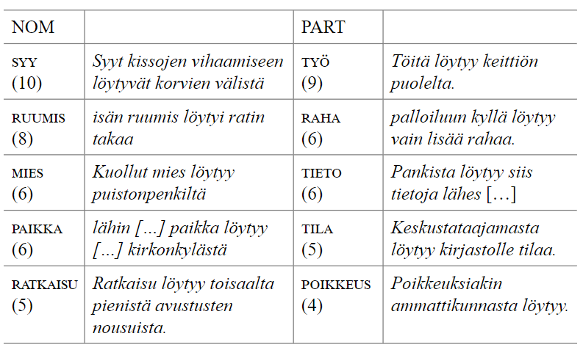
Most common lemmas (Basile & Ivaska 2021)

Slide 17
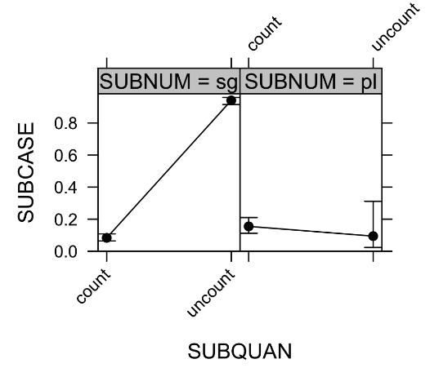
Quantity and number

Slide 18
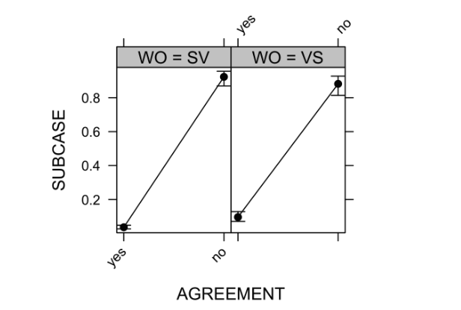
Agreement and word order
Agreement typically influences the choice of partitive in Finnish

Slide 19
Aitäh! Kiitos! Köszönöm!

Slide 20
References
Basile, Rodolfo. 2021. Situative constructions in European languages. In Spevak (ed.), 39–40. Book of Abstracts: 54th Annual Meeting of the Societas Linguistica Europaea. http://www.sle2021.eu/downloads/SLE%202021%20BOOK%20OF%20ABSTRACTS.pdf (Accessed 9-6-2022).
Basile, Rodolfo. Situative Strategies and Constructions in European Languages. OSF, 25 Apr. 2022. Web.
Basile, Rodolfo, and Ilmari Ivaska. 2021. Löytyä-verbin konstruktioiden yhteydessä esiintyvä subjektin sijanvaihtelu. Eesti ja soome-ugri keeleteaduse ajakiri. Journal of Estonian and Finno-Ugric Linguistics, 12(1), 11-39.
Creissels, Denis. 2014. Existential predication in typological perspective. Working Paper. Available online: http://www.deniscreissels.fr/public/Creissels-Exist.Pred.pdf.
Freeze, Ray. 1992. Existentials and other locatives. Language 68(3), 553–595.
Hakanen, Aimo. 1972. Normaalilause ja eksistentiaalilause. Sananjalka, 14(1), 36-76.
Helasvuo, Marja-Liisa. 1996. Ollako Vai Eikö Olla-Eksistentiaalilauseen Subjektin Kohtalonkysymys. Virittäjä 100 (3): 340–340.

Slide 21
Huumo, Tuomas. 2003. Incremental existence: The world according to the Finnish existential sentence.
Huumo, Tuomas. 2010. Nominal aspect, quantity, and time: The case of the Finnish object. Journal of Linguistics, 83-125.
Huumo, Tuomas, and Marja-Liisa Helasvuo. 2015. On the Subject of Subject in Finnish. Subjects in Constructions–Canonical and Non-Canonical, 13–41.
Huumo, Tuomas, and Liina Lindström. 2014. Partitives across Constructions: On the Range of Uses of the Finnish and Estonian ‘Partitive Subjects’. Partitive Cases and Related Categories 54: 153.
Larjavaara, Matti. 2019. Partitiivin Valinta. Suomalaisen Kirjallisuuden Seura
McNally, Louise. 2011. Existential sentences. In: Maienborn. Claudia & Von Heusinger, Klaus & Portner, Paul (eds.). Semantics: An International Handbook of Natural Language Meaning. Handbücher zur Sprach- und Kommunikationswissenschaft 33, 2. Berlin: Mouton de Gruyter, 1829–1848.
Seržant, Ilja A. 2021. Typology of partitives. Linguistics, 59(4), 881-947.

